Slide 1

Liberty Protection Safeguards (LPS)
For supported living, extra-care housing and shared lives
Rachel Griffiths
Consultant: MCA and Human Rights

Slide 2
What we will cover today about Liberty Protection Safeguards (LPS)
What is going to happen – and when?
What will LPS mean for providers of care in community settings?
What can we do now to be ready?
Resources and reasons not to panic

Slide 3

What will happen?
The way we protect the rights of people who need to be deprived of their liberty will change from deprivation of liberty safeguards (DoLS) to liberty protection safeguards (LPS)

Slide 4
Only applies to people who lack capacity…
All providers must work within the Mental Capacity Act when people using the service are 16+ and lack capacity
Capacity is ALWAYS ‘decision and time specific’ – can this person make this decision at the time it is needed?
LPS will only apply when someone lacks capacity to consent to the ‘arrangements’ – or care plan – needed to give them essential care or treatment; and if
These arrangements amount to a deprivation of the person’s liberty

Slide 5
What is deprivation of liberty?
‘Acid test’
Someone lacking capacity is deprived of their liberty if they are:
Under complete and effective supervision and control (not necessarily ‘line of sight’ but staff or carers know what they’re doing & where) and
Not free to leave (meaning, not free to go and live somewhere else)

Slide 6

However good the care plan, a ‘gilded cage is still a cage’
Lady Hale, Supreme Court ‘Cheshire West’ case [2014] UKSC 19

Slide 7
Deprivation of liberty and restraint
The MCA defines restraint as
Using, or threatening, force to make someone do something they are resisting or
Restricting their freedom of movement whether they resist this or not
There are always restraints in a deprivation of liberty, but an individual restraint is not of itself deprivation
Recognise and record restraint; always ask yourself if it is necessary to prevent harm to this person, and a proportionate response
See MCA code of practice chapter 6

Slide 8
What is staying the same? The vital purpose
Both DoLS and LPS protect the human rights of people who
Lack capacity to consent to the arrangements to give them the care or treatment that they need; and
Those arrangements amount to deprivation of liberty, but are
In their best interests, and necessary to prevent harm to them, and a proportionate response to how likely / serious that harm would be
Both systems also protect staff from liability who are depriving someone of their liberty when there is no less restrictive option

Slide 9
What’s NEW (1)
The headlines
Lots of people were missing out on these protections
DoLS only apply in care homes and hospitals; LPS will apply in all settings, including supported living, shared lives and people’s own homes
DoLS apply from age 18 upwards; LPS from age 16

Slide 10
What’s New (2)
LPS system is intended to be SIMPLER than DoLS
fewer ‘weird rules’, less jargon, less bureaucratic
more flexible and intuitive (and cheaper)
can be extended more easily and for longer
can cover someone in different settings and transport (day care, respite, hospital) if this is planned

Slide 11
What’s New (3)
New bodies to run LPS, called Responsible Bodies
Expanded role for Independent Mental Capacity Advocates (IMCAs)
New role: Approved Mental Capacity Professional (AMCP), to examine the proposed arrangements if either:
  There is reason to believe the person objects to the arrangements, or
  The person is receiving care in an independent hospital.
This latter aims to protect extremely vulnerable people with autism and LD, though may ‘catch’ many hospices.

Slide 12
3 assessments for LPS
1 Does the person lack mental capacity to consent to the arrangements? (assessed by doctor, SW, OT, psychologist, nurse or SALT). Should be part of care planning.
2 Do they have a mental disorder? (doctor or psychologist). Should be part of care planning.
Are the arrangements necessary to prevent harm to this person and proportionate to the likelihood and seriousness of harm to them? (same assessors as 1) Must be new.
This final assessment is called ‘Necessary and Proportionate’, N & P: at the heart of deciding if this level of restriction is justified.

Slide 13
What will it mean for different providers?
Care homes for the elderly
relatively small changes to language and the processes, still dealing with the same local authority in a fairly similar way as DoLS
Supported living, extra-care housing, Shared Lives settings, services for 16/17s
Currently commissioners/LAs apply to Court of Protection if someone is deprived of their liberty
Providers will have to learn to work within new process
Will not have to arrange or carry out assessments / authorisations

Slide 14
Practical implications for SL etc.
Must already work within MCA
Won’t often be involved in depriving someone of their liberty: people in their own homes can retain a lot of freedom and privacy
Must maintain and understand LPS records, welcome assessors and IMCAs
CQC will monitor LPS as part of existing oversight & in currently unmonitored settings (own homes, housing with care, shared lives)

Slide 15
Who will run LPS?
LPS will be run by Responsible Bodies, who are
The hospital manager, when the person’s care is mainly provided by an NHS hospital (in Wales: Health Boards, like DoLS now)
The Clinical Commissioning Group - in future Integrated Care Board - if the person’s main care is NHS Continuing Health Care (in Wales: Health Boards)
The local authority, for all care homes and community settings in England/Wales, and also in England for independent hospitals (in Wales: that’s right, Health Boards)

Slide 16
Responsible body for community social care
In both England and Wales, almost always the local authority
‘No Wrong Door’ principle: you do your best to get it right, the RBs must all cooperate and ensure the right body acts
Responsibility for identifying possible deprivation and referring the situation to the RB is for everyone: healthcare, social worker, care provider, relatives and friends: no statutory forms/process
RB is responsible for carrying out process of assessment, pre-authorisation review, authorising (or not), reporting to monitoring bodies, informing people of authorisations within 72 hours

Slide 17
When will LPS start?
No definite date: see next slide for government time-line
Probably not before Autumn 2023 – maybe early 2024
Timetable allows for at least 6 months pre-implementation training, this will start after next winter

Slide 18
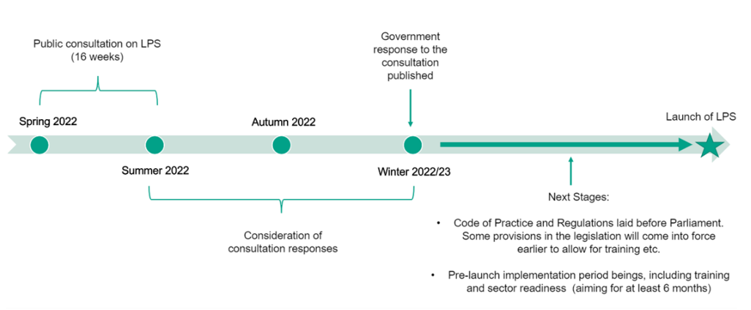
Government time-line for LPS

Slide 19
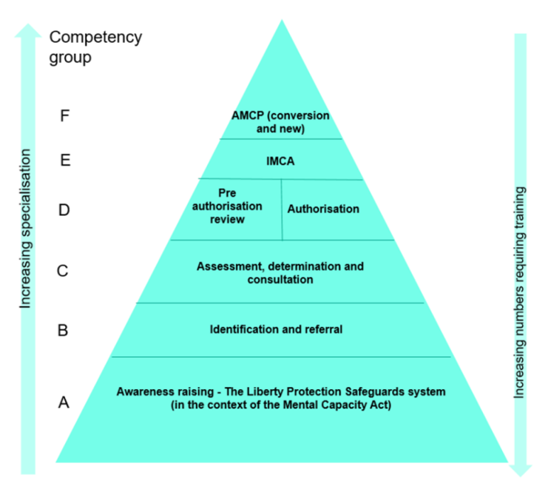
Government Training Triangle

Slide 20
Public consultation on MCA code and LPS (closes 14 July)
A revision of the existing MCA code – updates and clarifications – plus chapters on LPS and regulations for England and Wales
Many documents ☺ and a useful summary. We are planning a full response to all the documents.
Let government know your thoughts about how this will work in practice and what is clear and what is confusing
See link to consultation documents in Resources

Slide 21
How do LPS protect the person’s rights?
Sometimes you have to deprive someone of their liberty, to keep them safe from serious harm, to give them the care or attention they need.
These Safeguards
Identify when someone is or will be deprived of liberty, provide advocacy
Arrange checks on whether they do lack capacity to make this decision, do have a mental disorder, and whether the arrangements are necessary and proportionate.
Give them a right to review, & challenge to the Court of Protection.

Slide 22
Start getting ready (1)
Put the MCA 5 Principles at the heart of your service
1 Assume capacity unless there’s a reason to question it
2 Do all you can to enable people to make their own decisions
3 Don’t say someone lacks capacity just because others think it’s unwise
4 If someone lacks capacity, act in their best interests
5 Always look for a less restrictive option to meet their needs

Slide 23
Start getting ready (2)
Ensure staff work confidently within the MCA and always ‘hear the voice’ of the person and those who know them besst
Always ask yourself, about any restriction, is this both necessary and proportionate? And record why
Collect assessments (mental capacity & mental disorder) relating to people you support
Look out for, and join, local implementation groups

Slide 24
Start getting ready (3)
Use these RESOURCES
Read and respond to the public consultation (by 7 July) here https://www.gov.uk/government/consultations/changes-to-the-mca-code-of-practice-and-implementation-of-the-lps
See the Government LPS factsheets page here https://www.gov.uk/government/publications/liberty-protection-safeguards-factsheets
For latest news: https://www.gov.uk/government/collections/mental-capacity-amendment-act-2019-liberty-protection-safeguards-lps
Extra consultation in Wales, regulations, etc., here https://gov.wales/liberty-protection-safeguards

Slide 25

LPS are part of the MCA which is part of human rights

Slide 26
Don’t panic!
Remember that this new system is intended to be
Simple and flexible, putting the person at its heart, hearing their voice throughout
More intuitive and less bureaucratic
A protection for our most vulnerable fellow citizens aged 16 and over, who lack capacity but need to have their freedom very restricted to keep them safe and give them the care they need.

Slide 27

Questions and Answers?

