Slide 1

Liberty Protection Safeguards (LPS)
What do they mean for Care homes?
Rachel Griffiths
Consultant: MCA and Human Rights

Slide 2
What we will cover today about Liberty Protection Safeguards (LPS)
What is going to happen – and when?
What will LPS mean for managers of care homes?
What can we do now to be ready?
Resources and reasons not to panic

Slide 3

What will happen?
The way we protect the rights of people who need to be deprived of their liberty will change from deprivation of liberty safeguards (DoLS) to liberty protection safeguards (LPS)

Slide 4
Only applies to people who lack capacity…
All providers must work within the Mental Capacity Act when people using the service are 16+ and lack capacity
Capacity is ALWAYS ‘decision and time specific’ – can this person make this decision at the time it is needed?
LPS will only apply when someone lacks capacity to consent to the ‘arrangements’ – or care plan – needed to give them essential care or treatment; and
These arrangements amount to a deprivation of the person’s liberty

Slide 5
What is deprivation of liberty?
‘Acid test’
Someone lacking capacity is deprived of their liberty if they are:
Under complete and effective supervision and control (not necessarily ‘line of sight’ but staff or carers know what they’re doing & where) and
Not free to leave (meaning, not free to go and live somewhere else)
However good the care plan, a ‘gilded cage is still a cage’ Lady Hale, Supreme Court ‘Cheshire West’ case [2014] UKSC 19

Slide 6

A gilded cage is still a cage

Slide 7
Protections for people deprived of liberty
If someone is deprived of their liberty, the LPS process makes sure that
There is no less restrictive option available
The person really does have a mental disorder and lack capacity for these decisions
The plans to give them the care or treatment they need are both necessary and proportionate
LPS, like DoLS, gives the person the right to challenge these arrangements, through the system or to the Court of Protection

Slide 8
Deprivation of liberty and restraint
The MCA defines restraint as
Using, or threatening, force to make someone do something they are resisting or
Restricting their freedom of movement whether they resist this or not
There are always restraints in a deprivation of liberty, but an individual restraint is not of itself deprivation
Recognise and record restraint; always ask yourself if it is necessary to prevent harm to this person, and a proportionate response
See MCA code of practice chapter 6

Slide 9
What’s NEW (1)
The headlines
Lots of people were missing out on these protections
DoLS only apply in care homes and hospitals; LPS will apply in all settings, including supported living and people’s own homes
DoLS apply from age 18 upwards; LPS from age 16

Slide 10
What’s New (2)
LPS system is intended to be SIMPLER than DoLS
fewer ‘weird rules’, less jargon, less bureaucratic
more flexible and intuitive (and cheaper)
can be extended more easily and for longer
can cover different settings and transport, if this is planned

Slide 11
What’s new 3:
3 assessments for LPS
1 Does the person lack mental capacity to consent to the arrangements? (assessed by doctor, SW, OT, psychologist, nurse or SALT)
Do they have a mental disorder? (doctor or psychologist)
Are the arrangements necessary to prevent harm to this person and proportionate to the likelihood and seriousness of harm to them? (same assessors as 1)
This final assessment is called ‘Necessary and Proportionate’, N & P
It is at the heart of deciding if this level of restriction is justified.

Slide 12
What will it mean for different providers?
Supported living, Shared Lives settings, home care, services for 16/17s
Currently commissioners/LAs apply to Court of Protection if someone is deprived of their liberty
Providers will have to learn to work within new process
Sometimes a learning curve about the wider MCA
Will not have to arrange or carry out assessments / authorisations

Slide 13
What about care homes?
Already familiar with DoLS: similar in many ways, often simpler
Need to know how to recognise restraint, what is deprivation of liberty, how will LPS work and where to find out more information
Like other care providers, will not be responsible for assessments and decision-making within LPS

Slide 14
The vital purpose remains
Both DoLS and LPS protect the human rights of people who
Lack capacity to consent to the arrangements to give them the care or treatment that they need; and
Those arrangements amount to deprivation of liberty, but are
In their best interests, and necessary to prevent harm to them, and a proportionate response to how likely / serious that harm would be
Both systems also protect staff from liability who are depriving someone of their liberty when there is no less restrictive option

Slide 15
How do LPS protect the person’s rights?
Sometimes you have to deprive someone of their liberty, to keep them safe from serious harm, to give them the care or attention they need.
These Safeguards make it easier to
Identify when someone is or will be deprived of liberty
Arrange checks on whether they do lack capacity to make this decision, do have a mental disorder, and whether the arrangements are necessary and proportionate.
Give them a right to challenge, to the Responsible Body or to the Court of Protection.

Slide 16
Transition year from DoLS to LPS
From LPS implementation day, there can be no new DoLS
Anyone on a DoLS authorisation on implementation day will stay on it, unless it is challenged, until it expires
After that, switch to LPS (might use some existing assessments)
So DoLS will dwindle in number; after a year (max. authorisation period) no DoLS, only LPS

Slide 17
Responsible body for care homes: local authority (like now)
LPS will be run by Responsible Bodies, who are
The hospital manager, when the person’s care is mainly provided by an NHS hospital (in Wales: Health Boards, like DoLS now)
The Clinical Commissioning Group (in future Integrated Care Board) if the person’s main care is NHS Continuing Health Care: (in Wales: Health Boards)
The local authority for all care homes and community settings, and also for independent hospitals (in Wales: that’s right, Health Boards)

Slide 18
LPS less rule-based
Anyone can refer a potential dol to the RB
Authorisation can last up to 3 years if situation is stable
Can cover a range of settings – own home, hospital stay, day care, respite - if pre-planned
Existing assessments can be used if relevant; care planning includes LPS from the start (e.g. Care Act)
No ‘urgent authorisation’: instead, protection from liability if either it’s an emergency or authorisation has been requested

Slide 19
Some new situations
If the person receives CHC in England, the Responsible Body is not the LA but is the Integrated Care Board (taking over from CCG)
If a person’s ‘main care’ is provided by an NHS hospital, but, say, they are in ‘step down’ to a care home, the RB remains the Trust running that NHS hospital
If a person is cared for at home but comes to a care home for day care or respite, a single authorisation can cover – or not – all these settings, plus transport.
Must think, is THIS care plan for THIS person HERE a dol?

Slide 20
S4B instead of ‘urgent’
Four conditions:
Purpose of dol is to give life-sustaining treatment or a ‘vital act’
Steps taken are necessary to achieve this
Decision-maker believes the person lacks capacity to consent to these steps
Application to Court or to RB for LPS authorisation is under way OR there is an emergency

Slide 21
When will LPS start?
No definite date
See next slide for government time-line
Probably not before Autumn 2023 – maybe early 2024
Timetable allows for at least 6 months pre-implementation training, this will start after next winter

Slide 22
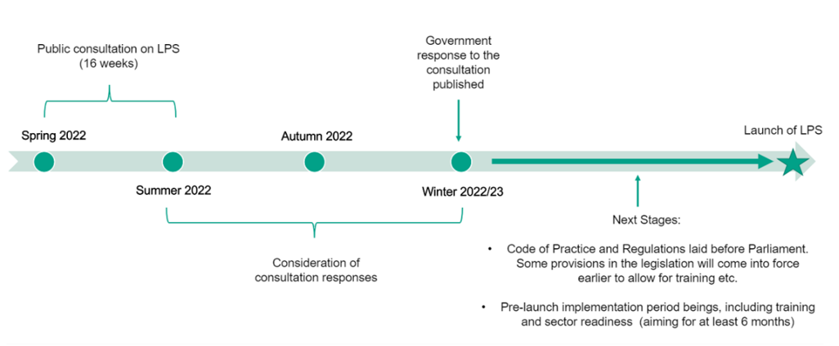
Government time-line for LPS

Slide 23
Public consultation on MCA code and LPS
A revision of the existing MCA code – updates and clarifications – plus chapters on LPS and regulations for England and Wales
Many documents ☺ and a useful summary.
In places the draft is unclear or seems contradictory
Let government know your thoughts about how this will work in practice and what is clear and what is confusing
See link to consultation documents in Resources

Slide 24
Code unclear about what is a dol
Chapter 12 of draft Code: uses ‘acid test’ but scenarios seem to stretch this very far
Do not rely on the draft Code in decision-making about deprivation of liberty
For the time being we have DoLS, contact your LA DoLS team if you are in doubt
Ultimately not your decision: currently SB, in future RB!

Slide 25
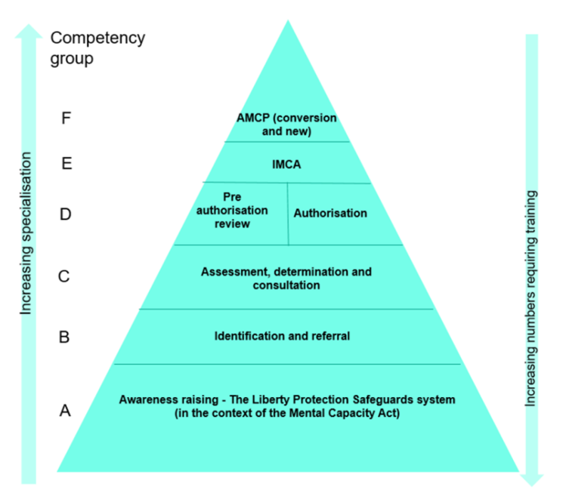
Government Training Triangle

Slide 26
To be ready (1)
Put the MCA 5 Principles at the heart of your service
1 Assume capacity unless there’s a reason to question it
2 Do all you can to enable people to make their own decisions
3 Don’t say someone lacks capacity just because others think it’s unwise
4 If someone lacks capacity, act in their best interests
5 Always look for a less restrictive option to meet their needs

Slide 27
To be ready (2)
Ensure staff work confidently within the MCA
Always ask yourself, about any restriction, is this both necessary and proportionate? And record why
Collect assessments (mental capacity & mental disorder) relating to people you support
Look out for, and join, local implementation groups

Slide 28
To be ready (3) use these RESOURCES
Read and respond to the public consultation (by 14 July) here https://www.gov.uk/government/consultations/changes-to-the-mca-code-of-practice-and-implementation-of-the-lps
See the Government LPS factsheets page here https://www.gov.uk/government/publications/liberty-protection-safeguards-factsheets
For latest news: https://www.gov.uk/government/collections/mental-capacity-amendment-act-2019-liberty-protection-safeguards-lps
Extra consultation in Wales, regulations, etc., here https://gov.wales/liberty-protection-safeguards

Slide 29

LPS are part of the MCA which is part of human rights

Slide 30
Don’t panic!
Remember that this new system is intended to be
Simple and flexible, putting the person at its heart
More intuitive and less bureaucratic
A protection for our most vulnerable fellow citizens aged 16 and over, who lack capacity but need to have their freedom very restricted to keep them safe and give them the care they need.

Slide 31

Questions and Answers?

