Slide 1
Integrated Care Systems
Policy and Engagement Update
Frances Newell and Anton Obholzer
System Strategy, Policy & Partnerships team
NHS England and NHS Improvement
Monday 9th May 2022
Working together for better health and care

Slide 2







The journey to integrated care systems
2014
2016
2019
2021
NHS and local government leaders set out a vision of more collaboration in the NHS Five Year Forward View
NHS and local councils form partnerships through the Better Care Fund to consider health and care priorities and plan services together.
NHS Long Term Plan confirms that every area will be served by an ICS by 2021; systems set their own priorities in local long-term plans; NHS recommends that Government unblock legislative barriers to integrated care.
England is covered by 42 ICSs; NHSEI recommends ICSs are created in law, reflected in DHSC’s White Paper; Health and Care Bill is introduced to Parliament.
The COVID-19 pandemic strengthens health and care partnerships; NHSEI describe how systems will operate in future years and update proposals to put ICSs in law after extensive engagement with stakeholders.
Some more mature partnerships began to take on more responsibility by becoming ‘integrated care systems.’
‘Vanguard’ sites in 50 areas began to develop and test new models of care.
2015
2018
2020

Slide 3

A changing landscape
Our health and care needs are changing, and services must adapt to reflect this so everybody benefits from them.
Health and care organisations must work collaboratively to address the complex issues that people encounter.
The COVID-19 pandemic has highlighted the importance of collaboration between health and care organisations - between health, local authorities, social care providers, the VCSE sector and other partners.
We need the right legislative framework to support the recovery, by improving outcomes, reducing health inequalities and making best use of limited resources.

Slide 4
Establishing statutory ICSs
Integrated Care Systems (ICSs) are partnerships of organisations that come together to plan and deliver joined up health and care services to improve the lives of people in their area.
The Health and Care Act will establish 42 ICSs across England on a statutory basis. Each ICS will have:
Integrated Care Partnership (ICP) - a statutory committee jointly formed between the NHS Integrated Care Board and all upper-tier local authorities that fall within the ICS area. The ICP will bring together a broad alliance of partners concerned with improving the care, health and wellbeing of the population, with membership determined locally. The ICP is responsible for producing an integrated care strategy on how to meet the health and wellbeing needs of the population in the ICS area.
Integrated Care Board (ICB) - a statutory NHS organisation responsible for developing a plan for meeting the health needs of the population, managing the NHS budget and arranging for the provision of health services in the ICS area. When ICBs are legally established, clinical commissioning groups (CCGs) will be abolished.

Slide 5
Other important ICS features
Place based partnerships will lead the detailed design and delivery of integrated services across their localities and neighbourhoods. The partnerships will involve the NHS, local councils, community and voluntary organisations, local residents, people who use services, their carers and representatives and other community partners with a role in supporting the health and wellbeing of the population.
Provider collaboratives will bring NHS providers together to achieve the benefits of working at scale across multiple places and one or more ICSs, to improve quality, efficiency and outcomes and address unwarranted variation and inequalities in access and experience across different providers.

Slide 6
Social care provider engagement
Engagement activity; social care providers and ICSs
An ICS communications campaign toolkit for health & care staff in all sectors to build knowledge of ICSs and their role. This is in the final stages and is due to be published this week. We will cascade materials when finalised.
Explainer for the social care providers sector on the ICS landscape. Due to be published May/June in co-production with the Care Providers Alliance.
Review of opportunities and challenges for social care providers sector engagement in ICSs.
Commissioned via Kings Fund and due to be published in May, the report will build on existing insights from stakeholder engagement and highlight existing and emerging approaches for engagement of the sector in ICSs to inform future development work in 22-23.
Integration index – new national service user and carer survey looking at experience of integrated care.
Currently exploring involvement of sector in development via NCF and CPA
Guidance on clinical and care professional leadership in ICSs.
This gives an opportunity for the sector to get involved in leadership development at system level, and we are actively encouraging this from the centre

Slide 7
Models of Engagement

Slide 8
Clinical & Care Professional Leadership
What is the Clinical and Care Professional Leadership Framework?
Each ICB is expected to agree a local framework and plan for clinical and care professional leadership with ICS partners and ensure this is promoted across the system.
The framework should demonstrate how clinical and care professionals will be involved in all aspects of ICS decision-making, building on and aggregating clinical and professional leadership in neighbourhood and place. It should make clear how appropriate and equal professional representation will be achieved and how the leadership community will reflect the diversity of the communities served.
ICS implementation guidance on effective clinical and care professional leadership, September 2021

Slide 9
Clinical & Care Professional Leadership
Clinical and Care Professional Leadership programme, led by the Leadership and Learning team
A community of practice has been established in association with this leadership programme to share approaches and considerations as the focus shifts to implementation.
Current learning:
The importance of engagement across the full range of clinical and care professional leaders to ensure the approach addresses the variety of issues and experiences of professionals working in the system.
Different approaches to structure/governance are needed to enable clinical and care professional leadership. This could include a clinical and care ‘senate’, ‘council’ or ‘executive group’, that includes care leadership colleagues, and reports directly into the ICB Board.
Language is crucial when articulating the narrative and vision for multi disciplinary leadership across a system.
If you or your systems would like to be included in the community of practice or have any queries in relation to clinical and care professional leadership please email maria.smith1@nhs.net

Slide 10
Embedding the VCSE sector in ICSs
National Development Programme, led by the Voluntary Partnerships team
Aim: To develop diverse and inclusive system level VCSE Alliances in all 42 ICSs that -
Encourage and enable the sector to work in a coordinated way;
Provide the ICS with a single route of contact and engagement with the sector and communities of place and interest as system, place and neighbourhood levels;
Better position the VCSE sector in an ICS enables it to contribute to the design and delivery of integrated care and have a positive impact on heath priorities, support population groups and reduce health inequalities.
Impact: VCSE sector leaders/representatives are embedded in ICS governance and decision-making structures. The sector works with system partners to influence, inform and deliver plans that will reduce health inequalities and deliver the integration of health and care.
Delivery Model:
Supporting participation in the programme through developing networks that link the system level alliances/groups with the wider VCSE sector.
Facilitation support led by a national partner NAVCA to encourage the development of the VCSE alliance.
Developed resources including an interactive toolkit for ICS and VCSE colleagues.
Contact: england.voluntarypartnerships@nhs.net

Slide 11
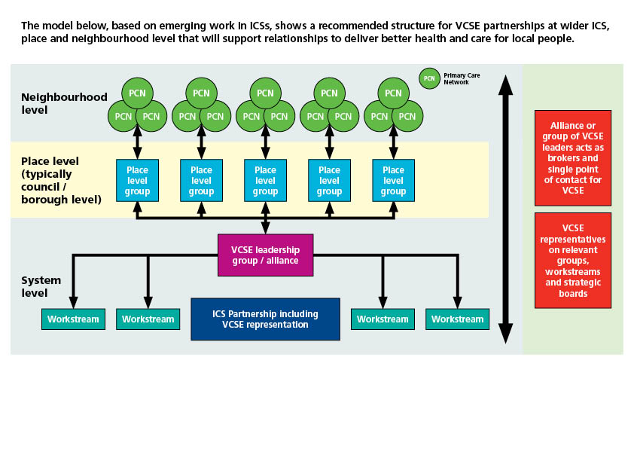
Model for VCSE strategic engagement

Slide 12
Voluntary Sector Surge Programme Overarching Ambition
Mobilise voluntary sector assets to enhance resilience within health, care and the community.
Voluntary Sector Surge Programme
A long-term sustainable programme, across the NHS, which allows systems to call off surge capacity support from voluntary sector providers when needed to reduce system pressures.
2021-2022
Nationally commissioned voluntary sector surge capacity to support recovery and resilience in the NHS for key priorities. Delivered by British Red Cross, Royal Voluntary Service and Age UK.
2022 - 2023
Continuation of delivery for current programme by British Red Cross, Royal Voluntary Service and Age UK. Current surge support will end June 30th 2022.
Regional winter planning must includes the offer of the surge programme.
Networking with ICS VCSE Alliances and smaller VCSE organisations to promote the framework for delivery.
Medium Term: Recovery and Resilience | Long Term: Sustainability
Develop a longer term programme with VCSE providers into a longer-term programme to provide surge capacity from the voluntary sector when required. To be in place Winter 21/22 Explore mobilising additional support for key NHS recovery priorities such as stand up of elective care and supporting people with long covid. | Embed a sustainable programme across NHS which allows NHS to call off surge capacity support from voluntary sector when it is needed (e.g. during winter) for key NHS priorities Continue to champion voluntary sector assets within integrated care systems (ICSs) to enhance out of hospital support and integrated care

