Slide 1

The Adult Social Care Workforce Strategy
Sarah Gilbert and Fran Simons
Workforce Strategy Implementation Unit, Skills for Care
ASCworkforcestrategy@skillsforcare.org.uk
Notes:
sarah

Slide 2
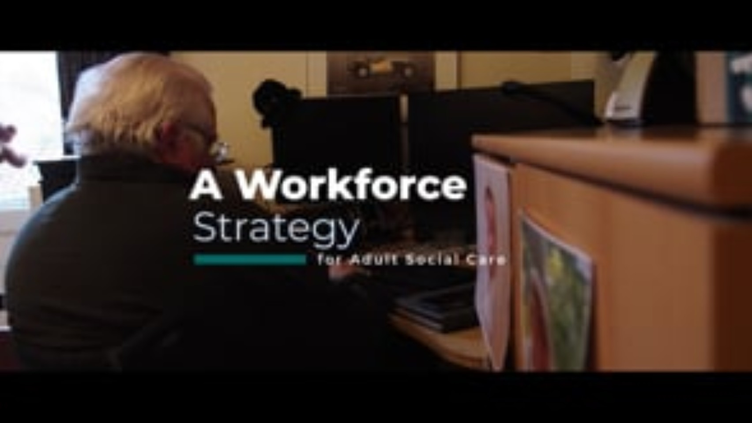
Notes:
Sarah
Play video – giving a over view of purpose of strategy

Slide 3

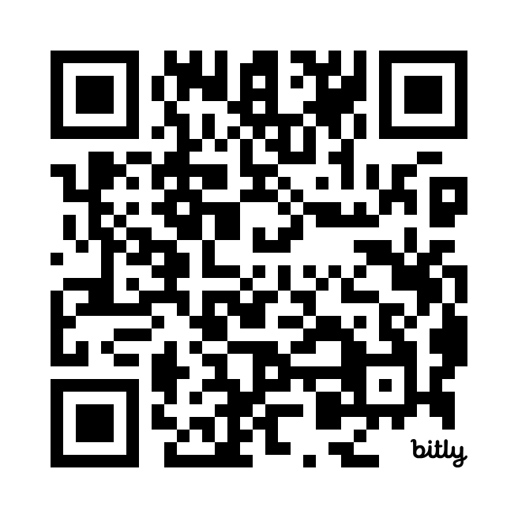
Attract and retain
Train
Transform
www.ascworkforcestrategy.co.uk
Notes:
Sarah
So first just to give you a quick reminder of the adult social care sector’s workforce strategy, which was developed by the sector with the sector and published in July 2024. There are 3 key areas in the strategy, that mirror the NHS long term plan - attract and retain, train, transform. Within these areas there are a total of 56 recommendations and commitments that cover the whole of the adult social care sector.
The steering group (made up of the real movers and shakers in our sector) who oversaw the development of the strategy has turned into the oversight executive group to oversee the implementation. They will meet quarterly and we had a face to face meeting in London on 13th January.

Slide 4


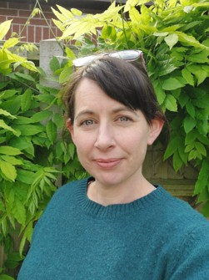

The Workforce Strategy Implementation Unit
Jane Brightman
Director of Workforce Strategy
Sarah Gilbert
Head of Workforce Strategy Implementation Unit
Fran Simons
Senior Workforce Strategy Project Manager
Juliet Green
Senior Workforce Strategy Project Manager
Notes:
Sarah
We have the new workfroce Strategy Implementation Unit in place now with Jane Brightman leading the team with support from myself, Fran Juliet as project managers. The unit has been set up to support the sector to deliver recommendations in the Workforce Strategy.
*Say something about it's a partnership effort but having this coordination at SfC helps us to pull the levers and report on progress from both us and partners*

Slide 5

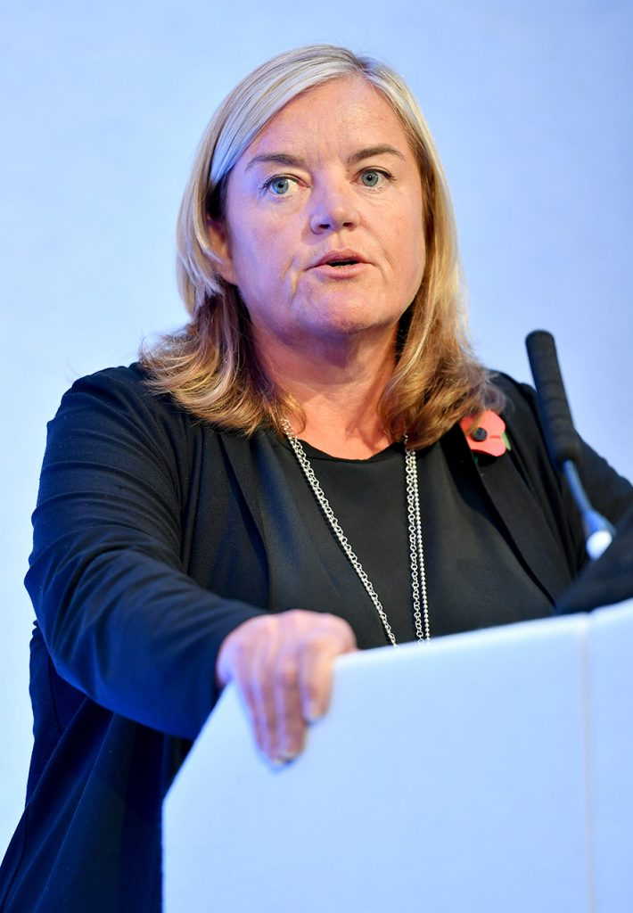
The current context
Three strategic shifts
1
Hospital
Community
2
Analogue
Digital
3
Sickness
Prevention
The Oversight Executive Group: the ambassadors for the Workforce Strategy, advocating for and supporting delivery of the recommendations and influencing decision makers.
Notes:
Sarah
Before I go on with details of the work of the strategy, its important to mention the current policy context.
We have a new (ish) government and we are mindful that the workforce strategy was developed and launched before the current government was in place.
We know that the strategy doesn't represent the previous government’s policy - but we also need to ensure that we are very clear in our communications about how the strategy meets the policy priorities of our new government (and speaks in their language) .
I’m sure lots of you are aware that over Christmas The Government has announced an independent commission into adult social care, chaired by Crossbench Peer Baroness Louise Casey (pictured here), including the establishment of a National Care Service, which was a commitment Labour made during the general election.
we know that the workforce strategy is helping with the issues that the commission want to focus on – we know that the commission will be focusing on things like delegated healthcare and a career framework, so we will be showing the commission that the strategy is already bringing the sector together to look at these areas. Also as work is already happening they could be seen as an ‘easy win’ for the commission.​
Then the other key area of focus for the government is their three strategic shifts in health – moving from hospital to community, analogue to digital and sickness to prevention. We’ve been doing some work to show how the strategy supports these shifts so that we can speak the governments language and continue to influence them.
This wider context is important for us to be aware of and the Oversight Executive Group (and the sector as a whole) continue to speak in one voice to influence and engage with the government to show them that For the first time ever, the adult social care sector has come together to develop the Workforce Strategy it needs, working closely with colleagues in health and education. The most important thing that the Government can do to address the challenges facing the sector is to prioritise and adopt recommendations from the Strategy – and to engage as we continue to learn and re-prioritise. ​
From previous influencing slide:
Oversight Executive Group: This cross-sector group is meeting quarterly to govern implementation. They are ambassadors for the Workforce Strategy, advocating for and supporting delivery of the recommendations.
Minister for Care, Stephen Kinnock MP announced a commitment to dementia training for social care staff. He hosted a roundtable with social care leaders. We talked with one voice about the importance of the Workforce Strategy and how it will help transform social care, showing that the whole sector is behind it.
CQC strong advocacy for the Workforce Strategy in 2024 ‘State of Care’ report.
Social Work England hosted a roundtable looking at what organisations can do to support this vital part of the regulated workforce and are planning a social work workforce strategy to align with the national Strategy.
Spending Review We want the whole Workforce Strategy to be considered. Oversight Executive Group members continue to have discussions with Government departments, and where possible Ministers, to share the wealth of evidence that we used in compiling the Strategy.

Slide 6
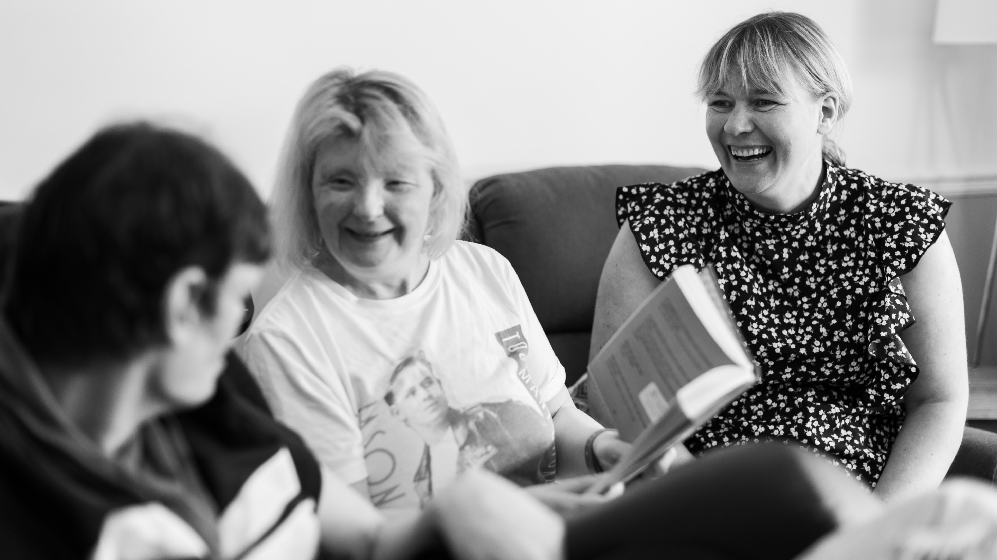
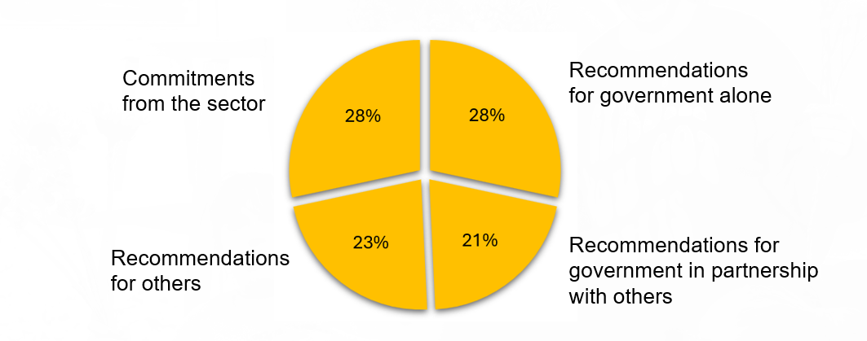
How's it going so far?
Attract and Retain
Train
Transform
Notes:
Fran
It's still early days but we wanted to show what progress has been made so far.
At the top left you can see the status of all the recommendations and commitments – for info there are are 38 recommendations and 18 commitments within the strategy (total 56). 5% of recommendations are complete, 23% are in progress and 71% are yet to start (data as at Dec 24).
The three pie charts at the bottom shows the status of the recommendations within the three areas of the strategy.
The Government are named as key levers for 49% of the strategy’s recommendations, highlighting the importance of the sector’s influencing role, and the need to continue to advocate for the strategy. The SfC Implementation Unit are working closely with our External Affairs team to develop and refine our influencing plans, consider how we use the valuable sector insight information, as well as opportunities for collective contributions across the Oversight Exec Group members and sector partners to drive the strategy.

Slide 7




Completed
New eLearning has been launched on public health and prevention by the Office for Health Improvement and Disparities and the Royal Society of Public Health
The Care Workers’ Charity hosted a focused day on wellbeing during Professional Care Workers Week in September
The revised statutory and mandatory training guide has been launched, Skills for Care and CQC are working together to share these across the sector
Notes:
Fran
Commitments that have been completed to date (Dec 24)
New eLearning has been launched in October 24 on public health and prevention by the Office for Health Improvement and Disparities (or OHID) and the Royal Society of Public Health.
The Care Workers’ Charity hosted a focused day on wellbeing during Professional Care Workers Week in September and I think there is agreement that this will feature in future care worker weeks.
And we launched the revised statutory and mandatory training guide on the day we launched the strategy
For LM info: Skills for Care colleagues sat on the expert reference group for the public health and prevention resource and we’ve been commissioned by OHID to promote this resource until end March and how we sustain interest beyond our contract.

Slide 8

In progress
Action: Implementation Unit to take forward the translation piece.
Alzheimer's Society dementia training report published
Government leading action on a Fair Pay Agreement
Promote adult social care place-ments in HEIs
Phase 2 of the Care Workforce Pathway
Scoping research proposal for registration of the care workforce
Care technologist role
3-year pilot by the National Care Forum
Developing Directors of Adult Social Services
Promotion of delegated healthcare activity principles
Notes:
Fran PICK OUT 3 examples
There are lots of activities that are in progress, but just to pick out a few to share with you:
The Alzheimers Society has published their dementia training report ‘Because we’re human too – why dementia training for care workers matters and how to deliver it’.
The main recommendation from the strategy that is being progressed by Government is the Fair Pay Agreement which is in early days and there’s a new group led by DHSC for this
​Work is underway with the Council of Deans for Health, Skills for Care and partners to develop a strategy to promote and support the value and opportunities for adult social care placements as a placement of choice in higher education institutions.
Work on phase 2 of the Care Workforce Pathway continues.
Research into the impact of adult social care regulation​: this will focus on the question Should the adult social care workforce be regulated? The project is being led by Skills for Care and Development and will focus on what can we learn from existing regulation of care workers in adult social care in various countries, focusing on the impact, the different models, and the implications and costs for regulating the adult social care workforce in England. ​ There is a paper going to the Alliance Board to seek approval and funds for the research at the end of January
NCF are leading work to pilot a new Care Technologist role, learning from Scotland and similar models in other countries, for example the Netherlands. They have got some funding from the Rayne foundation and the project is just getting going and will include the development of a Level 3 awardThe Care Technologist Project - Scottish Care
Skills for Care have launched two new face to face programmes in partnership with NDTi to support the development of Directors of Adult Social Services
This includes the
Becoming a Director of Adult Social Services programme (which replaces our ‘New Directors’ programme) and is for aspiring DASSs only. And the
Becoming a director in social care programme – This is a brand new programme and is for anyone who would like to become a director in an adult social care organisation.
Promotion of co-developed, sector led delegated healthcare activity principles to support person-centred, safe and effective delegated healthcare with the right governance, education, training and clinical decision-making and oversight.

Slide 9
Other areas the strategy will focus on
10 year attraction plan
Regulator actions
Support for new managers
Research the creation of a professional body for RMs
Wellbeing and EDI
Care Certificate Qualification
Review the CQCs fit person process
Foundation degree minimum education for RMs
Notes:
Fran Pick out 3 examples
The Strategy is a 15 year strategy, so there are several areas that are in the pipeline to work on that haven’t begun, – or areas we know the government aren’t focusing on at the moment but we know that work is happening in the sector…..
The Strategy recommends a national 10-year attraction plan focusing on men, younger people and people with tech skills. There is also a recommendation focusing on Attracting workers to social care in coastal and rural areas/ Although national work on these haven’t started we are aware that work in local areas has started to look at this, and I’m sure we will be coming to local areas to gather and share learning.
The CQC has a number of recommendations focused on regulator actions, as we all know CQC have been in a difficult place and have lots of work to do internally but they are members of the Oversight Executive Group and starting to pick up some of their recommendations
There are a few recommendations specifically for Registered Managers – one looking at support for new RMs and recommending that a enhanced support programme for new managers is piloted - similar in style to the support offered to newly qualified Social Workers.
One focuses on researching what would need to happen, the implications and costs for setting up a professional body for registered managers with a code of conduct, competency and development framework to include degree and master’s level qualifications.
And another looking at making it a requirement for care services to be led by a qualified registered manager with a minimum foundation degree qualification (level 5) and support opportunities for registered managers to undertake full degree programmes or master’s degree programmes.
Then there are also several recommendations focusing on wellbeing and Equality Diversity and inclusion including a commitment to support employers with guidance on prioritising staff wellbeing and tackling workplace harassment and violence. There is a recommendation on Promoting uptake of NHS Health Checks to adult social care workers (we know this is happening in some areas, with health check nurses coming to places of work to offer checks and in Staffordshire Health check nurse came to a RM network meeting and did checks for RMs at the meeting). And there is a focus on Workforce race equality, specifically focused on supporting the Social Care Workforce Race Equality Standards

Slide 10
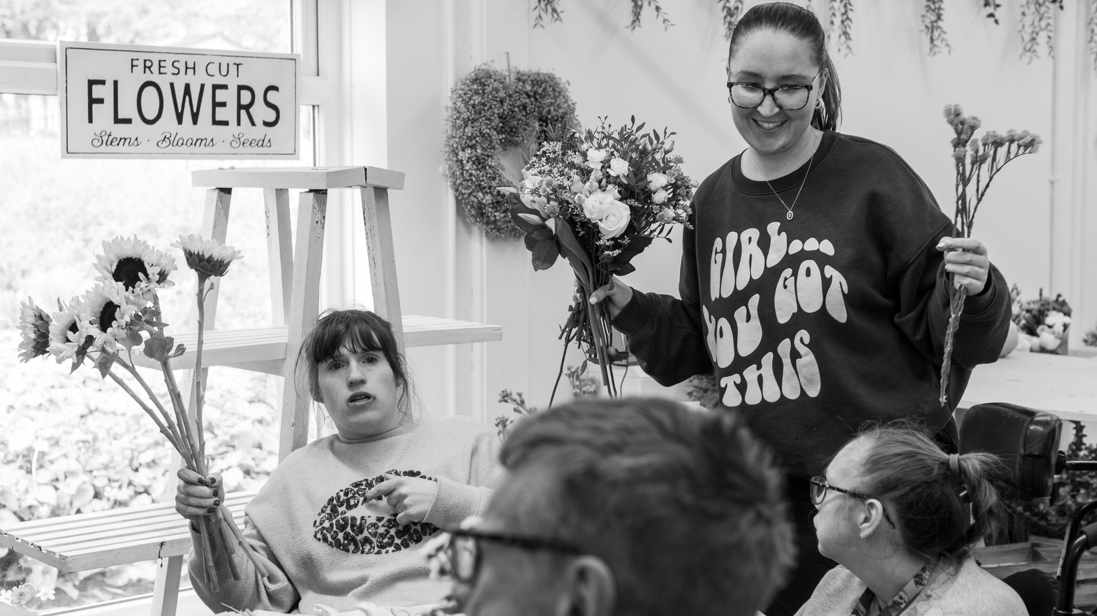



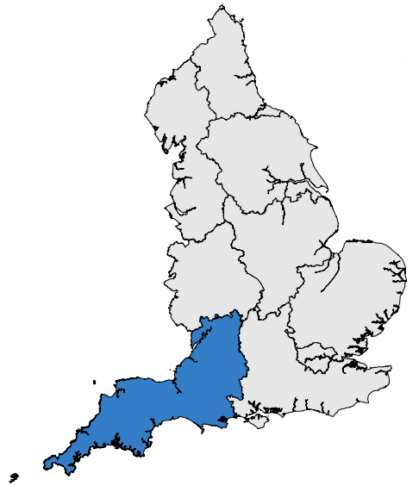
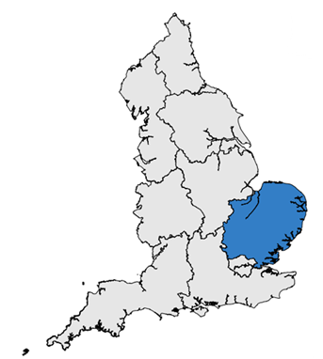
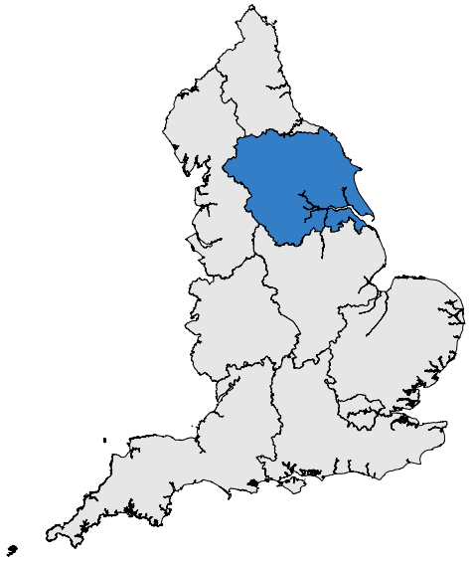
Area activity: integrated care systems (ICS) & local authorities (LA)
mapping
sharing practice
engagement with adult social care
Some examples from the regions
Notes:
Fran
There has been some great regional activity in response to the strategy launch, with more than half of ICSs mapping the national strategy to their own strategies. Many local authorities are also starting to do this. (Include as ask on RMs in the room to say get in touch with your ICB to see what they're doing and how you can work together / link with your LM)
(Pick some of the following to read out?)
There's been lots of progress in the South West which is becoming a leading example of partnership working and joint responsibility for the strategy. In Feb, the South West ICB agreed to formally recognise the WFS implementation group as an ICB subgroup. It includes representatives from ICS’s, regional NHSE, LAs, ADASS, South West Provider CEO network and care associations. This shows commitment to the strategy at a partnership and system level which could have a real impact in the area.
We are seeing progress against the recommendation for ICSs to establish a social care academy and shared technology approaches, in several areas. The Staffordshire & Stoke Social Care Academy (pilot) launched in Jan. The virtual learning portal offers a variety of courses for all roles, and information to support careers in care. It already has 220 active users (exceeding the target of 90.) Surrey Heartlands ICB also runs a successful academy and have recently launched a 'Career ambassador' programme to promote care careers.
A practical example of good practice is from Suffolk and North East Essex ICB, who are working with partners to produce a series of videos and supporting resources around flexible working and menopause for social care providers. The aim is to show employers how to improve staff wellbeing and retention.
In East of England an ICS launched a survey to help map workforce gaps & workforce development activity. The same ICS is working with their local authorities and universities to align their education and recruitment activity
There's been some progress against developing a People Promise for social care. NHSE East of England are looking to extend elements of the offer to the social care sector in ICS footprints, with most activity is taking place with the Cambridgeshire & Peterborough ICS. Elsewhere, North East ADASS and the ICB are looking to pilot the People Promise with six social care employers.

Slide 11
But what can you do as a registered manager?
Focus on staff wellbeing x
Use your data effectively and get familiar with the Adult Social Care Workforce Data Set (ASC-WDS)
Explore the Care Workforce Pathway
Understand the new statutory and mandatory training guide
Sign up as a Workforce Strategy Champion
Find out about the new funding for training scheme
Level up your technology and focus on digital skills of your workforce
Make Equality, Diversity and Inclusion a focus
Review your recruitment strategy
Focus your thinking on retention
Network
Stay up to date with priorities and changes in the sector
Notes:
Fran – pick out some – including Champions.
·Use your data effectively: If you’re not already, get familiar with the Adult Social Care Workforce Data Set (ASC-WDS), this is a free service that allows you to claim back training costs, maintain your training matrix, and benchmark your service against others. The data you provide is then used by decision makers to help them understand the state of the sector and helps us to monitor trends in the sector.
·Understand the new Statutory and Mandatory Training Guidance: This has replaced the old ‘Core and mandatory training guidance’ document. It has been designed to make it clearer for managers to understand which training is essential, either statutory (required by law) or mandatory (compulsory and determined by regulations or standards). It has also been designed to prevent the over-duplication and unnecessary repetition of training for workers. This should help to save time, money and reduce the burden on workers.
·Consider the wellbeing of your team: Wellbeing at work relates to every aspect of working life, from staying healthy, the working environment to how the workforce feels about themselves. Here are some resources to get you started. Encourage your workforce to find out about and take up any free NHS health checks that are available to them.
·Level up your technology: The adult social care sector is embracing the use of technology much more now and learning how different types of technology can improve the ways care and support is provided. Digital skills are vital for you and your team and there are some free programmes for you to access.
··Link with your Local Integrated Care System (ICS): ICSs across the country are mapping their local work to the Workforce Strategy. Contact them to find out what they are doing and how you can get involved. Your Skills for Care Locality Manager can help put you in touch with your ICS leads.
·Sign up as a Workforce Strategy champion and to help spread the word about the strategy.
we are building a network of champions to help spread the word about the strategy. We are still developing how this will work and what being a champions means but We see the workforce strategy champions connecting to andr developing grassroots networks to Support local and regional implementation of the strategy, share good practice, Take co-ordinated actions across employers and systems that drive improvement and inspiring others to co-create and innovate together.
WE are actually really interested to hear your views on the champions, what you think would be useful for the role, how we can link with champions and the types of things you are doing that would be useful to share through the champions. Any ideas please share!

Slide 12
Discussion points
Applying the recommendations to your work:
What are you already doing to support the strategy?
What else could you start doing?
What support do you need from others (Skills for Care and other partners)?
Becoming a workforce strategy champion:
What information, support or resources would you want as a workforce strategy champion?
What is your organisation doing well that you could share with other providers?
Do you have an area of interest that you'd like to work with others on finding solutions for?
Notes:
Sarah to introduce. We’ve shared some top tips for chord and we are interested in share what things on this list you are already doing (or other things)? Are there other things that you could do?
There are 2 pieces of flit chart paper on each table with these questions on – the first includes the top 3 questions focusing on the strategy in general, and the second focused on becoming a workforce strategy champion.
We have 20minutes now to discuss these questions on your table. Feel free to focus on either sheet first. Will let you know when you are half way
After 20minutes:
Any feedback, or questions? Any thing that came up that was interesting?
Want to spend a couple of minutes so you can capture some actions that you can take away. See the action sheet. Please detail 2 things that you are going to take from today, maybe sign up as a champion, test out an idea that was shared, tell us about some great innovative work you are doing – anything that struck a cord, note it down and take it away to action.

Slide 13
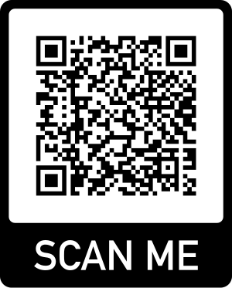
Stay connected
Visit the website: www.ascworkforcestrategy.co.uk
Contact the implementation unit at ASCworkforcestrategy@skillsforcare.org.uk
Contact your Skills for Care locality manager as a starting point to stay involved.
Sign up as a Strategy Champion
Notes:
Sarah
Thanks for having me, time for questions? I'm around all day. Her are some ways to stay connected – and what might be good actions to take forward and Sign up as a champion!

